Slide 1

Bundled Payments for Care Improvement Initiative–Continuity Assessment Record and Evaluation (B-CARE)
(Revised) Introduction to the B-CARE Assessment Tool
Webinar
DATE/TIME

Slide 2
Agenda
B-CARE Key Components
B-CARE Tool Format and Using the B-CARE Tool
B-CARE Tool Pages and Functionality
Awardee Time Commitment
Quality Support, Reports, and Monitoring
Notes:
Welcome to this training session for the B-CARE tool!
This training will cover background information about the B-CARE and its uses, specific instructions for using the tool as well as training support.

Slide 3


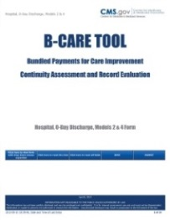
Key Components of B-CARE Tools
Administrative Items
Current and Present Service Use
Current Medical Information
Cognitive Status, Mood & Pain
Impairments
Functional Status
Overall Plan of Care
Discharge Status
Additional Information
Notes:
The B-CARE tool is divided into 10 separate segments as indicated here.

Slide 4
B-CARE Tool Format
Models 1, 2, and 4 are called “Hospital, 0-Day Discharge.” These models are performed in a hospital setting at discharge.
Model 3 is called “Post Acute Care, 0-Day Admission.” This model is performed at admission (in nursing homes, home health agencies, long-term care hospitals).
Notes:
The B-CARE tool for Models 1, 2 and 4 is called "Hospital, 0-Day Discharge" – it is to be done completed the day prior to discharge and day of discharge
The B-CARE for Model 3 is called "Post Acute Care, 0-day Admission“ – is to be completed at admission

Slide 5
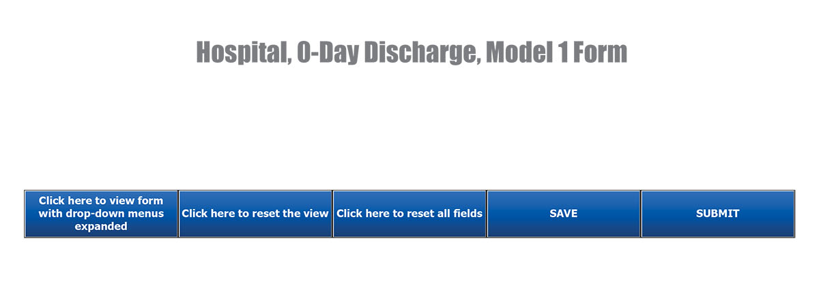
Model 1, Cover Page (Bottom of Page)
For Print
If you click on the first blue box on the left, the form will expand to include all of the drop-down menus on each page; if you are using a printed version of the B-CARE Tool, click on this box before printing. Note: If you have filled out any drop-down menus prior to clicking this button, those responses will be lost. Click the next button, “Click here to reset the view,” to view those responses again.
Information from the paper format B-CARE Tool will need to be entered into the Web portal following completion.
Notes:
PRINT FORMAT - On the first page of the B-CARE, there are three blue "click here" boxes at the bottom of the page.
If you click on the first blue box, on your left, the form will expand to include all of the drop down menus on each page - if you are using a printed version of the B-CARE, you want to click on this box before printing.
If you filled out any drop down menus prior to clicking the print form, those responses will be lost.
Information from the paper format B-CARE tool will need to be data entered into the web portal following completion.

Slide 6
Model 1, Cover Page (Bottom of Page)
If your facility chooses to use the B-CARE Tool in its electronic format, you will receive instructions from your B-CARE Coordinator on where to access the B-CARE Tool. The B-CARE Tool can be used online through the Web portal, or it may be used and stored on your facility’s secure computer network until it is completed.
The SAVE and SUBMIT buttons will be activated for those using the electronic format. Note that end users can SAVE their progress on each Tool but they will NOT be able to SUBMIT the completed Tool without the proper credentials.
Notes:
ELECTRONIC FORMAT - If your facility chooses to use the B-CARE in its electronic format, you will receive instructions on where to access the B-CARE tool from your B-CARE Coordinator. The B-CARE tool can be used online through the web portal, or may be used and stored on your facility's secure computer network until it is completed.

Slide 7
Using the B-CARE Tool
Sections with a clock icon should be completed during the 2-day assessment period.
Sections with an ear icon should be completed based on information from the patient or proxy interview.
Notes:
The B-CARE tool uses two icons to guide you on how the sections are to be completed. Pages with a clock icon are to be completed during the two day assessment period. Pages with an ear icon are to be completed face-to-face with the patient or their proxy.
The face-to-face requirement does not mean that a formal meeting must be set up with the patient or caregiver, but that the information must be gathered during time with the patient or proxy
In the patient's room during routine clinical work
Incorporate into patient interactions
If patient asks, you are collecting information for discharge planning

Slide 8
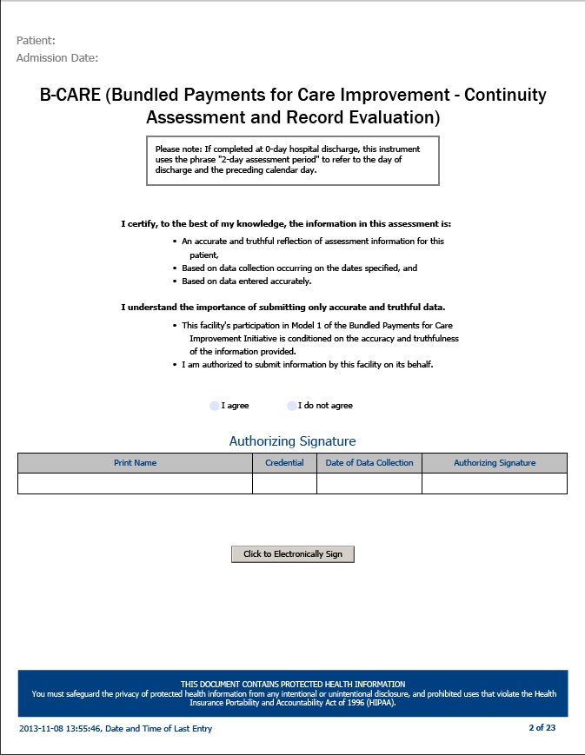
Authorization and Certification
Notes:
Authorization and Certification
Page 2 of the B-CARE tool is formatted to allow the end user to certify that the information entered into the B-CARE tool is
Accurate and truthful
Collected on the required dates, and
Entered accurately.
You should indicate agreement that you are authorized to submit the information on behalf of the facility (I agree).
Finally, enter your name, credentials, date and sign (either electronically or manually on the paper format version). NOTE: a licensed health care professional must sign here; if the B-CARE is completed by an unlicensed person, then a licensed health professional must sign the form.

Slide 9
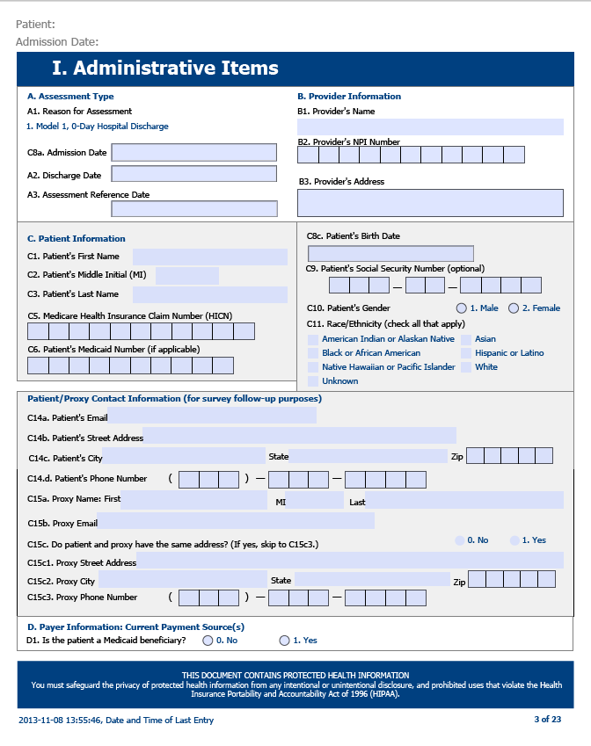
I. Administrative Items
Notes:
Administrative Items
Your facility might choose to have this section completed from admission information prior to distribution to the end user completing clinical and other information gleaned from the patient interview. Your Core Administrator will advise you of the process.
Section A: enter the patient discharge date. Assessment reference date is the day before discharge (NOTE: dates are MM/DD/YYYY)
Section B: Provider information pertains to the FACILITY. Enter the facility's full name, NPI (National Provider Identifier) and address.
Section C: Enter patient's full name (First, Middle and Last)
If any patient name is longer than the box provided, enter as many letters of the name as fit.
If the patient has a suffix such as "Jr.", "Sr." or "III" or "IV", enter them.
Do not enter professional titles (MD or JD)
Enter the patients' Medicare Health Insurance Claim Number (HICN) - TWICE.
Enter patient's date of birth
Enter patient's social security number
Enter patient's gender
Enter patient's race/ethnicity (this must be from the patient - do not guess!)
Enter patient's email and address. If a proxy answers questions for the patient, enter proxy address and phone number.
Enter patient's email address - TWICE. If patient does not have email, leave blank.
Enter patient's address and phone number.
If a qualified relative, guardian or friend provides patient information, enter identifying information for the proxy in Section C15.

Slide 10
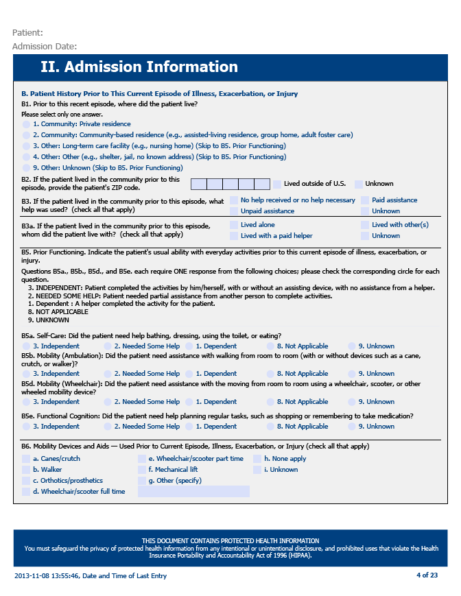
II. Admission Information
Notes:
II. Admission Information
These questions pertain to the patient's residence and functioning prior to the illness, injury or exacerbation of condition leading to hospitalization.
Indicate type of residence
Indicate - for those living in the community - the type of help they used
Functioning: For B5a - B5e select one criteria for level of functioning for each category.
Independent
Need some help
Dependent
Not applicable
Unknown
Indicate if the patient uses mobility devices and aids.
Indicate if patient has had one or more falls in the past year, or a fall with injury.

Slide 11
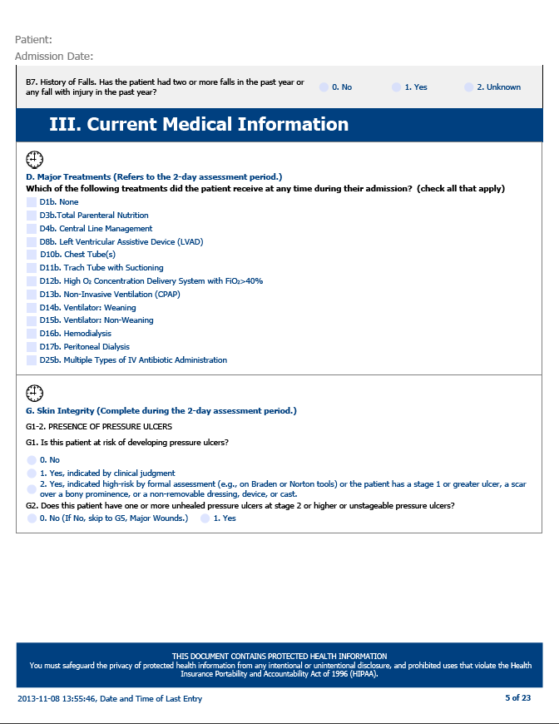
III. Current Medical Information
Notes:
Current Medical Information
This section documents the patient's medical condition during the two day assessment period including major treatments, skin integrity, wounds and height and weight.
D. major treatments: Check each block indicated
Specify most intensive frequency of trach tube suctioning
G. Skin integrity: Indicate presence of pressure ulcers
Indicate risk of pressure ulcers

Slide 12
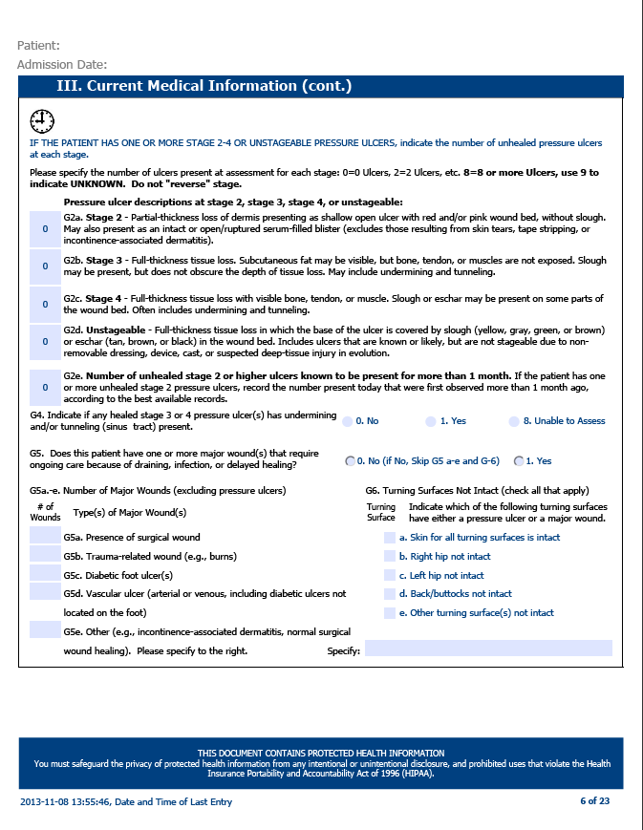
III. Current Medical Information (Continued)
Notes:
Indicate if patient has one or more unhealed pressure ulcers at stage 2 or higher or unstageable.
Indicate number of each
Indicate number of major wounds by type (exclude pressure ulcers)
Indicate which turning surfaces have a major wound or pressure ulcer.
H: Indicate patient's height and weight.

Slide 13
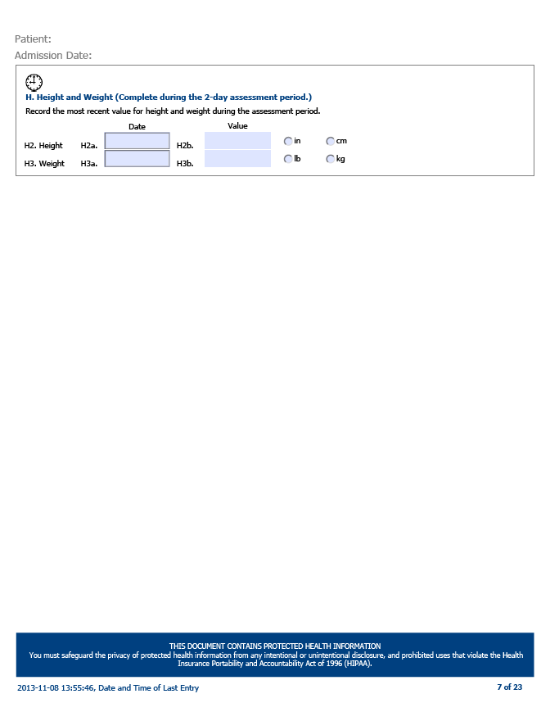
III. Current Medical Information (Continued, 2)

Slide 14
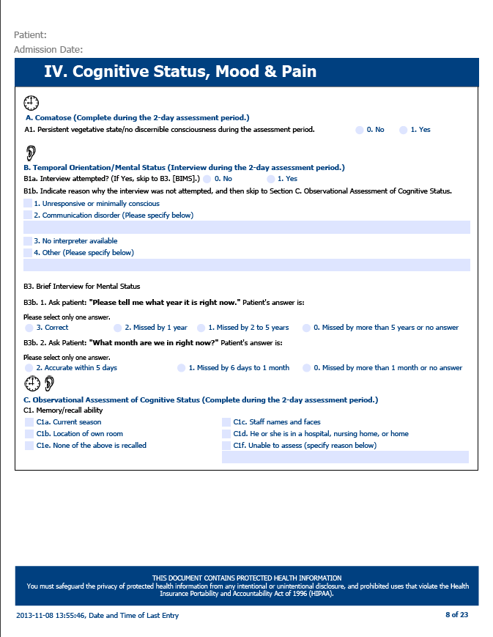
IV. Cognitive Status, Mood & Pain
Notes:
Cognitive Status, Mood and Pain
This section seeks documentation of the patient's temporal orientation, mental status, level of confusion, behavioral indicators for depression, mood and level of pain.
A: Indicate if patient is comatose
B: Indicate if interview was attempted; if not attempted indicate reason
B3: Brief mental status: query patient on year and month - indicate answers
C: Note observations of cognitive status: check all that apply
Memory/recall - give patient three words to remember (sock, blue, dresser)
Ask patient the current season
Ask patient location of their room
Ask patient your name (or name of other medical personnel in room)
Ask patient where they are

Slide 15
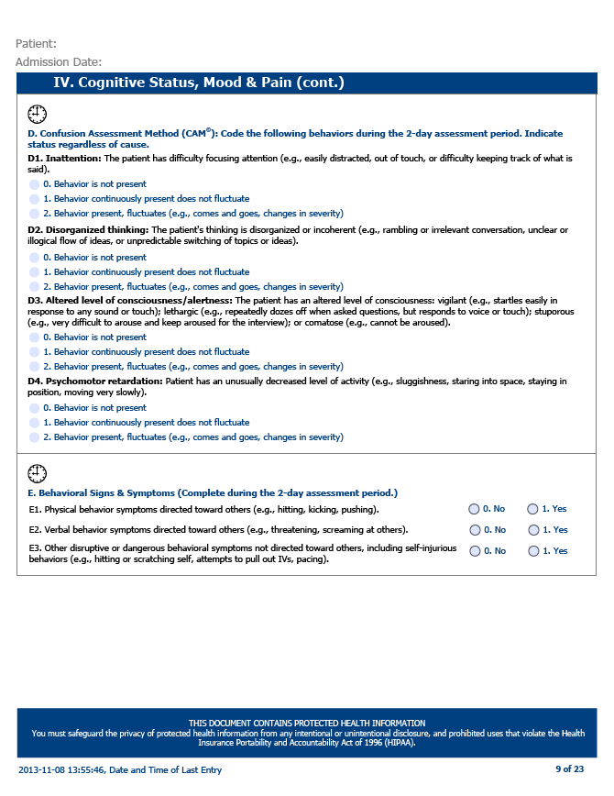
IV. Cognitive Status, Mood & Pain (Continued)
Notes:
D: Confusion Assessment Method (CAM): The CAM is a standardized and validated tool that has become the most widely used instrument for detection of delirium world-wide because of its strong validation results as well as its ease of use.
Indicate if interview was attempted; if yes, indicate behavior for each status (does not matter if the behavior may be caused by medication or treatment)
Inattention
Disorganized thinking
Altered state of consciousness/alertness
Psychomotor retardation
E: Behavioral symptoms: indicate if patient exhibits physical, verbal or other disruptive and dangerous behaviors.
F: Mood (Patient Health Questionnaire): Indicate if interview was attempted; if yes, indicate the answers to two questions (yes or no); if yes, indicate how many times in the past two weeks patient experienced these emotions.

Slide 16
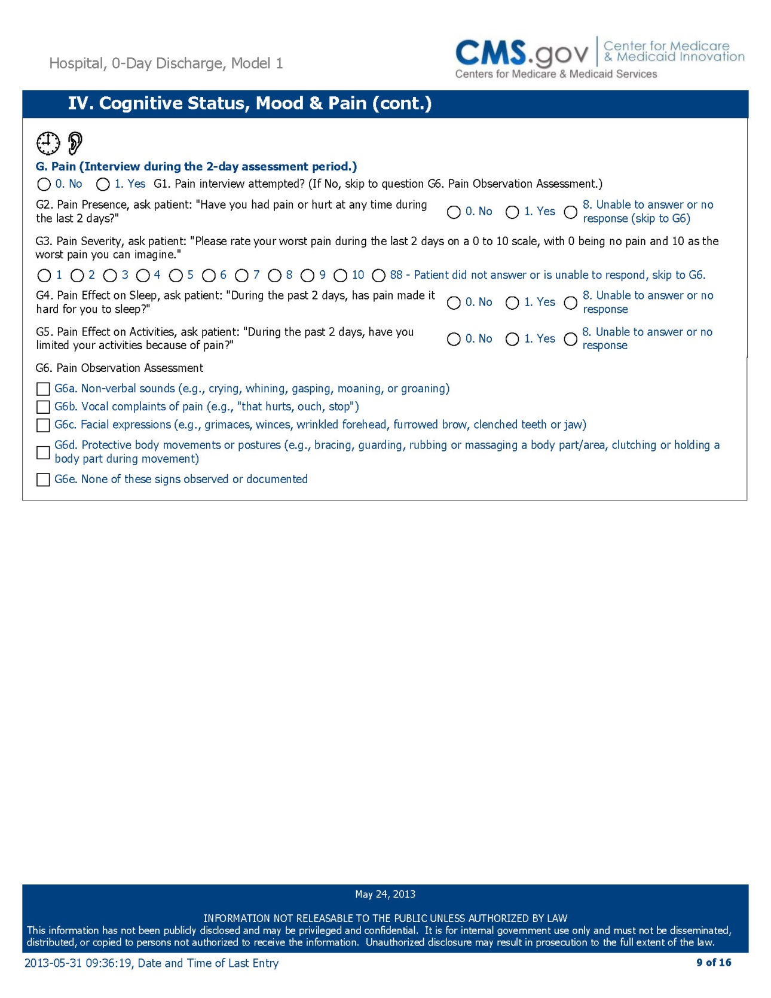
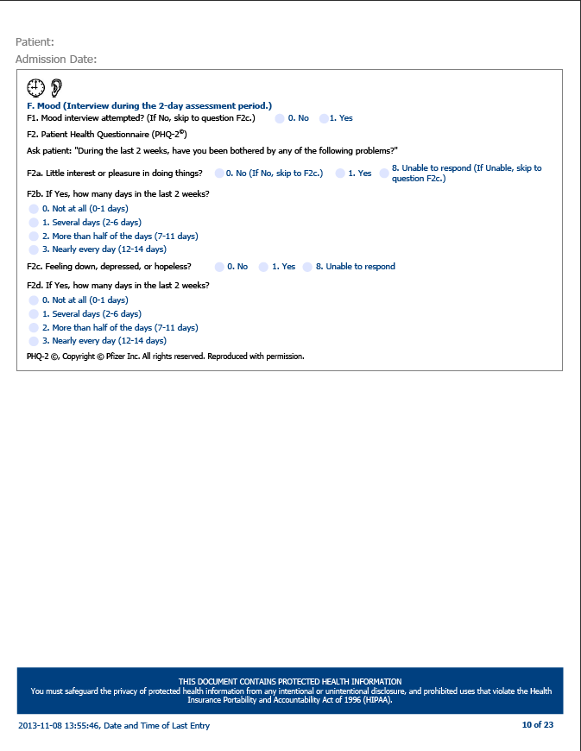
IV. Cognitive Status, Mood & Pain (Continued, 2)
Notes:
G: Pain: Indicate if interview was attempted; if yes, indicate pain presence, severity, effect on sleep, effect on activities.
Has the patient had pain in the past two days?
Ask Patient to rate pain on scale of 1-10
Has pain interfered with sleep the past two days?
Has pain interfered with activities the past two days?
G6. Document your pain observations.

Slide 17
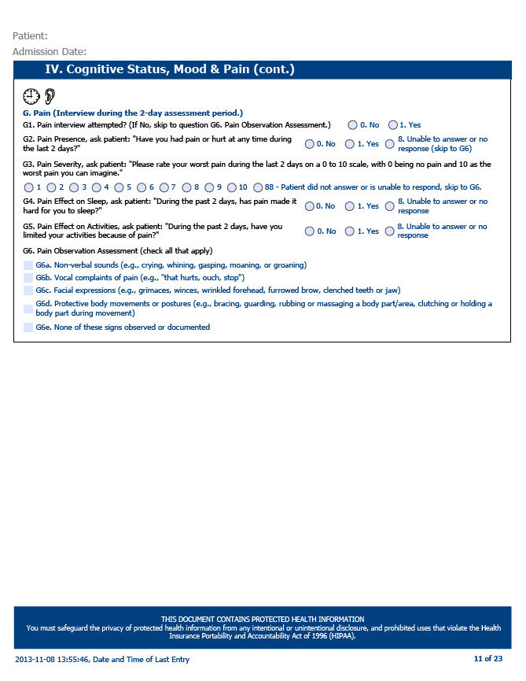
IV. Cognitive Status, Mood & Pain (Continued, 3)

Slide 18
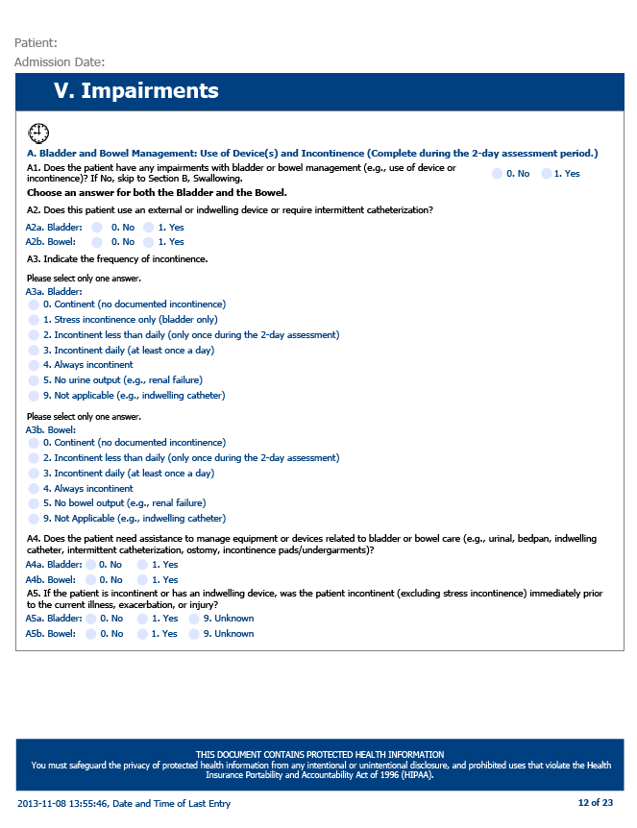
V. Impairments
Notes:
Impairments
This section seeks documentation of patient impairment during the two day assessment period in areas of bladder and bowel management, ability to swallow, verbal communication and understanding, respiratory status, mobility and sitting endurance, and the use of mobility devices and aids.
A: BLADDER AND BOWEL: Indicate if patient has impairments with bladder or bowel management.
Indicate any bladder or bowel issues as indicated:
External or indwelling device
Frequency of incontinence
Assistance with management of equipment or devices
If patient was incontinent prior to hospitalization
B: SWALLOWING: Indicate if patient can take food by mouth.
Check one box to describe patient's usual ability to swallow

Slide 19
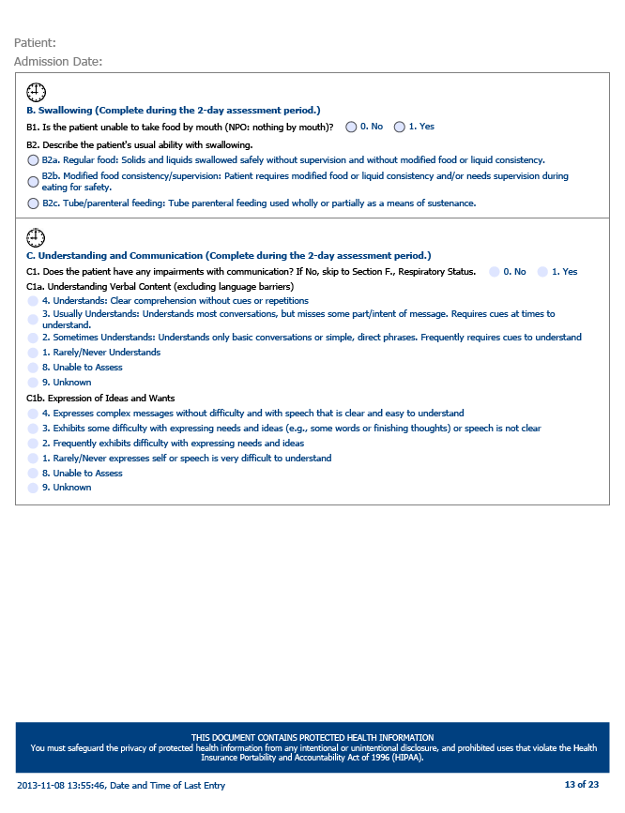
V. Impairments (Continued)
Notes:
C: UNDERSTANDING AND COMMUNICATION: Indicate if patient has hearing, vision or communication impairment.
Indicate the level of understanding of verbal content (exclude language barriers)
Indicate level of patient expression of ideas and wants
F: RESPIRATORY: Indicate if patient has any respiratory impairments
Indicate patient's respiratory status with and without supplemental oxygen.
G: ENDURANCE: Indicate if patient has any endurance limitations.
Indicate patient's ability to walk or wheel (with wheelchair or walker) 50 feet.
Indicate patient's ability to sit for 15 minutes.
H: Indicate all of the mobility devices used by patient (if not listed, describe in Other)

Slide 20
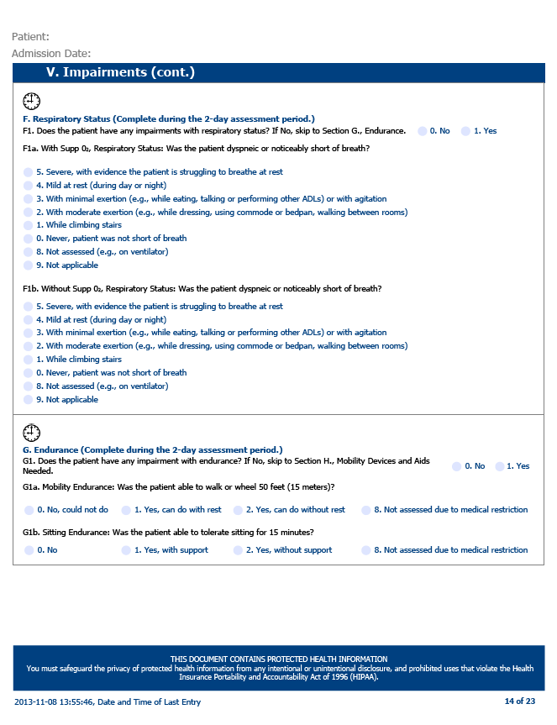
V. Impairments (Continued, 2)

Slide 21
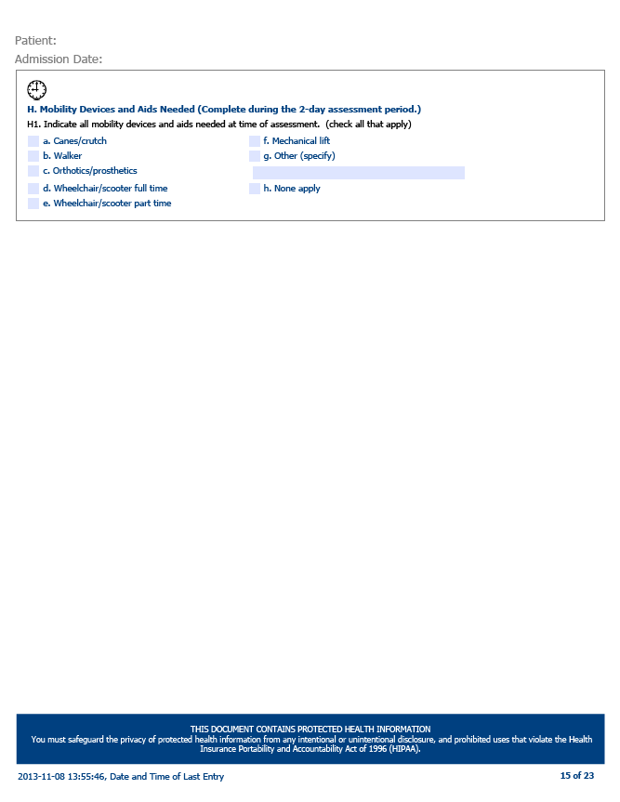
V. Impairments (Continued, 3)

Slide 22
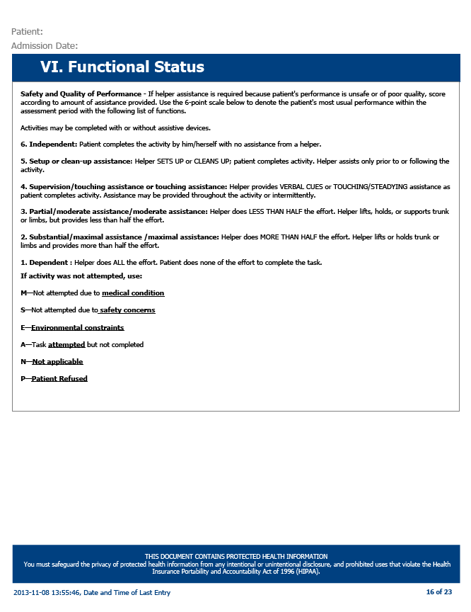
VI. Functional Status
Notes:
This page explains the ratings for functional status coding for questions starting on page 13.

Slide 23
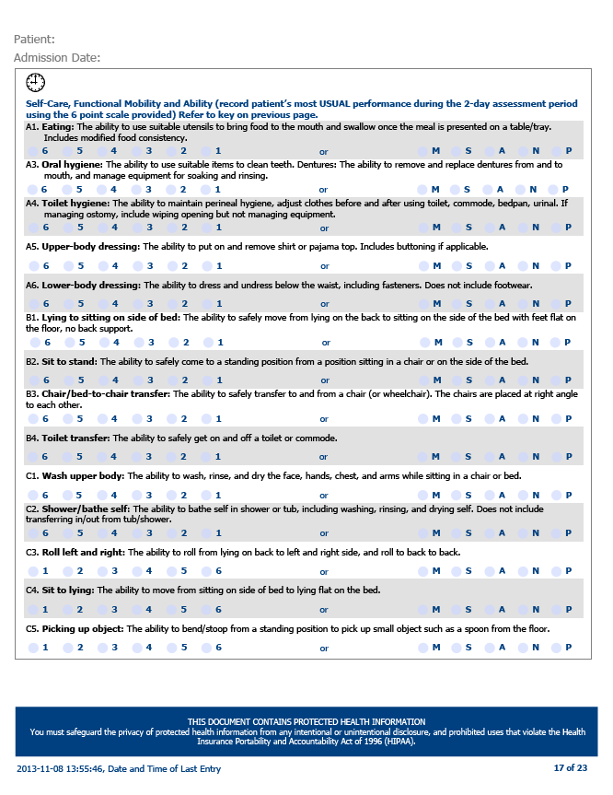
VI. Functional Status (Continued)
Notes:
Functional Status
This section documents the patient's ability to handle activities of daily living during the two day assessment period.
In this section, choose from the drop box the answer that best describes the patient's ability to perform the listed task. If the activity was not attempted, choose the reason why.
SELF CARE, FUNCTIONAL MOBILITY AND ABILITY: Indicate the patient's functional ability to perform each task:
Eating
Oral hygiene
Toilet hygiene
Upper body dressing
Lower body dressing
Lying to sitting on side of bed
Sit to stand
Chair/bed-to-chair transfer
Toilet transfer
Wash upper body
Shower/bathing self
Roll left and right
Sitting to lying
Putting on/taking off footwear
Does the patient primarily use a wheelchair for mobility
Can patient walk 50 feet with two turns
Can patient go up and down 4 steps

Slide 24
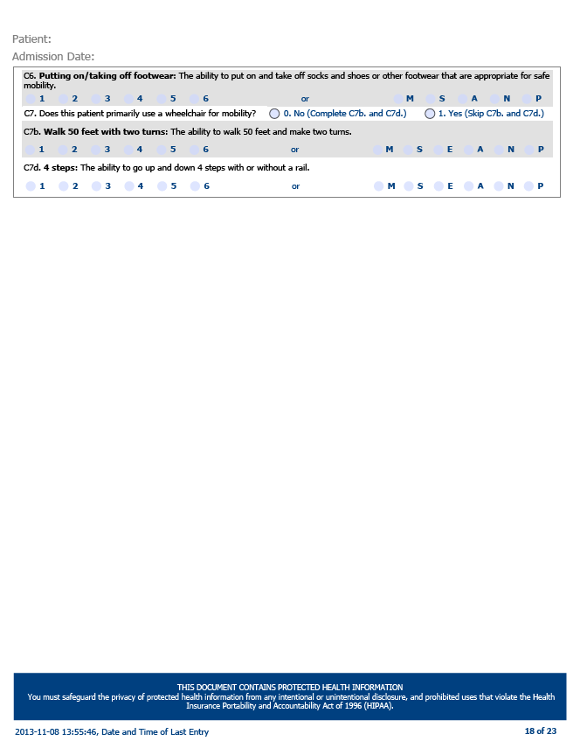
VI. Functional Status (Continued, 2)

Slide 25
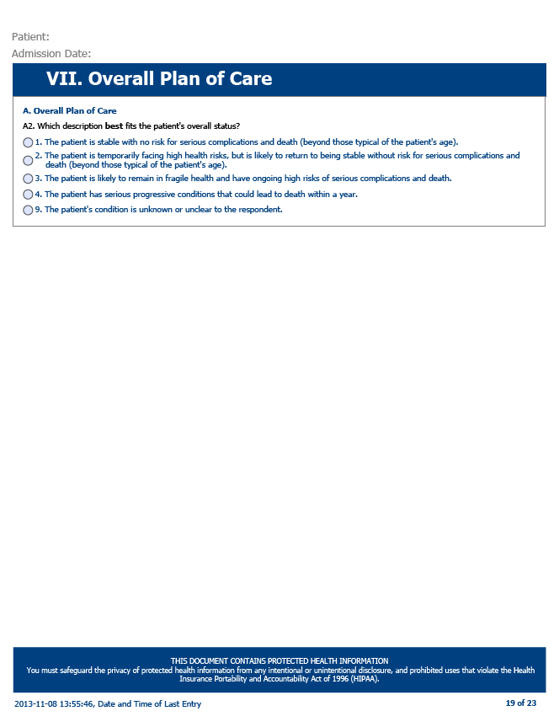
VII. Overall Plan of Care
Notes:
Overall Plan of Care
Indicate the best descriptor of the patient's overall status
Discharge Status (Models 1, 2 and 4)
Indicate discharge location
Indicate caregiver availability.
Indicate if patient has one or more willing caregivers
Indicate type of caregiver/relationship
B: Indicate type of residence at discharge (community location only)

Slide 26
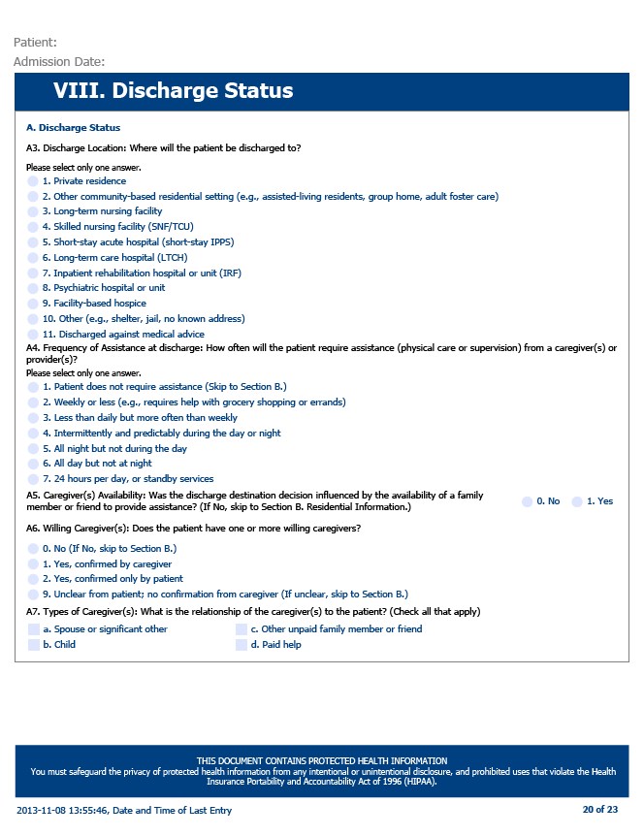
VIII. Discharge Status

Slide 27
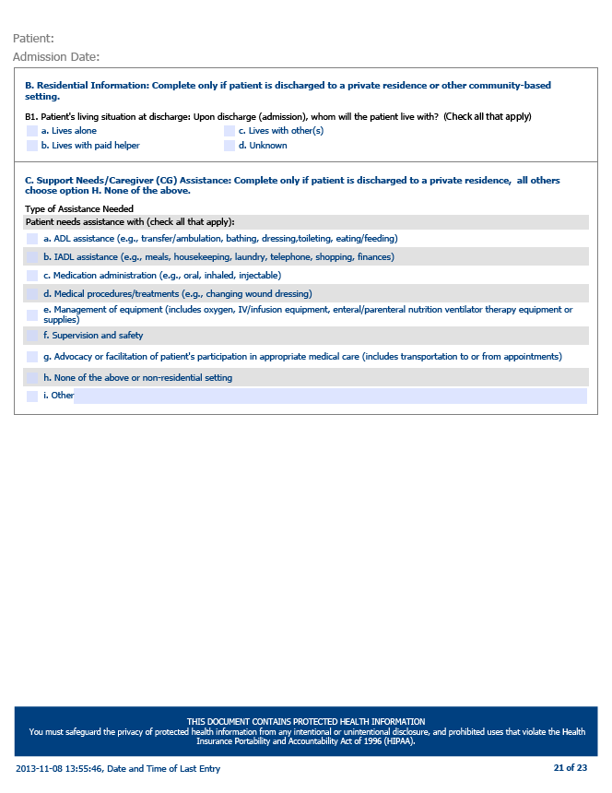
VIII. Discharge Status (Continued)
Notes:
C: Support Needs: Indicate each category in which the patient needs assistance
E: Discharge location with additional services: If patient is discharged with referral for services, indicate the name of the provider and check the appropriate box for type of services. Indicate city and state of provider.
Indicate if discharge was delayed for 24 hours and reason for delay
Complete the "Other Useful Information" textbox if there is additional information about the patient that should be shared with post acute providers.
Note Blue Buttons at the bottom of the page:
If you are using the B-CARE electronically, these buttons will allow you to save changes in the B-CARE tool or reset the tool to a blank form

Slide 28
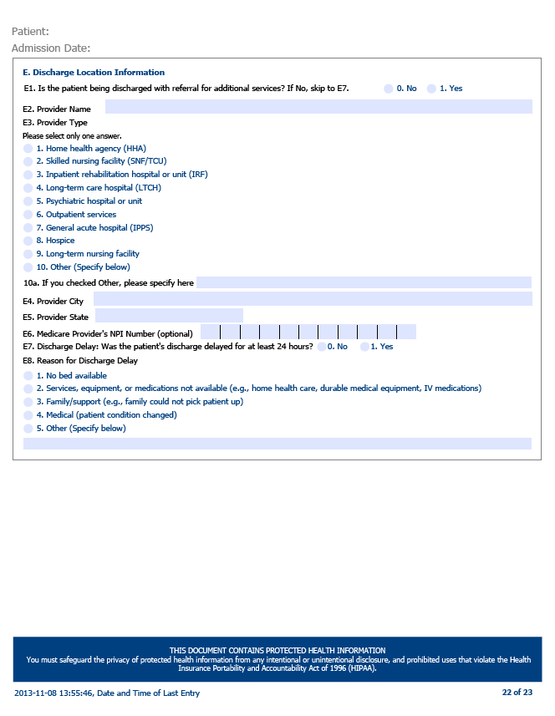
VIII. Discharge Status (Continued, 2)

Slide 29
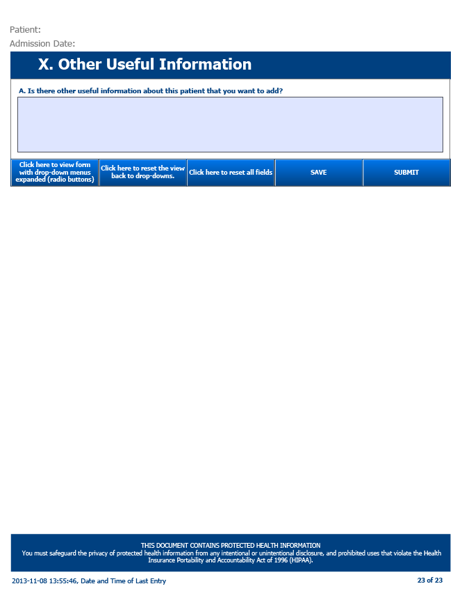
X. Other Useful Information

Slide 30
Awardee Time Commitments
For all Awardees, ongoing time commitments will vary, depending on:
Awardee B-CARE Tool Model.
The number of medical severity (MS)-DRGs the Awardee has selected to track.
The number of episodes the Awardee is tracking.
The episode length the Awardee assigns to each MS-DRG. (According to CMS, the majority of Model 2 and Model 3 applicants have elected 90-day episodes.)
The number of beneficiaries meeting the episode criteria.
The average length of time to administer the B-CARE Tool and enter data. (Presumably, as End Users become more proficient, this would decrease. This is also dependent upon the solution the Awardee employs (paper or electronic).
Retrieving/interpreting/reports.
Development and implementation of any retraining based on report results.

Slide 31
Quality and Support
For all Awardees, ongoing time commitments will include retrieving and interpreting reports to complete the B-CARE Tool elements and developing and implementing any retraining based on report results.
The data quality and completeness feedback loop promotes continuous improvement in the accuracy, completeness, and reliability of the data.
Additional information on the data collection system is forthcoming.
Notes:
*Announce Data System training here?

Slide 32
Quality and Completeness Feedback Loop
Master Trainer trains B-CARE Coordinators and End Users. Retrain if necessary.
End Users collect data and submit to database.
Econometrica IT team conducts quality and completeness check and forwards report biweekly to B-CARE Coordinators and Master Trainers.
Master Trainers and B-CARE Coordinators confer for next steps. B-CARE Coordinator shares results with End Users.
Master Trainers and B-CARE Coordinators review report and look for opportunities for improvement in quality and/or completeness.

Slide 33
Quality Reports and Monitoring
Reports:
Quality Report.
Completeness Report.
Monitoring:
May develop systematic review of B-CARE tools for completeness.
Review management reports on B-CARE submissions.
Target quality improvement corrective action plans for identified problems.

Slide 34
Thank you for your participation!

